Slide 1

Ocean
Cleanup
Cindy Chang | Huyen Nguyen | Jiakun Luo | Aishwarya Bhangale

Slide 2
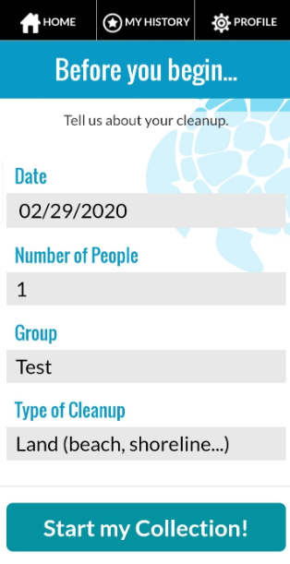
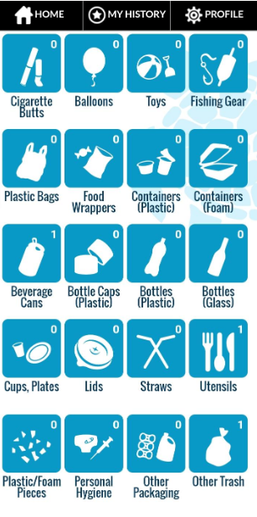
Cleanswell App : Beach Cleanup Data
Target Customers
Non-Profit Ocean Cleanup Organisations
School children
People that live near the beach
Businesses located near the beach
The tourism industry business in various states

Slide 3
Summary
1
Exploratory Data Analysis
State-wise analysis
Type of trash collected
The effect of individuals and groups on beach cleanup
Prediction
Prediction of human resources for ocean cleanup in the US in the future.
3
2
Recommendations
Organization
CleanSwell apps
Technology like floating garbage collectors and plastic detecting drones

Slide 4
State-Wise Analysis
1
Which states perform a highest number of cleanups and which perform the lowest?
2
Which are the states that produce the maximum and minimum trash (in pounds)?
3
Which states might have problems of human resources allocation for ocean cleanup?

Slide 5
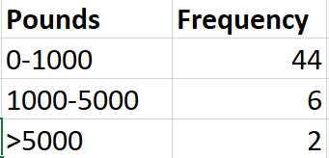
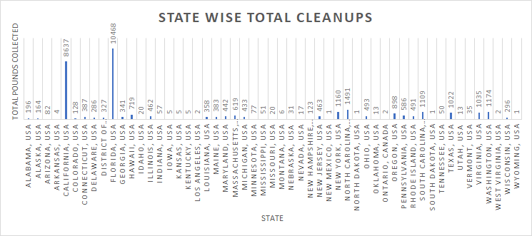
Which states are actively cleaning?
California and Florida:
Have more than 8000 cleanup records
3000 more cleanup records than all the other states combined

Slide 6
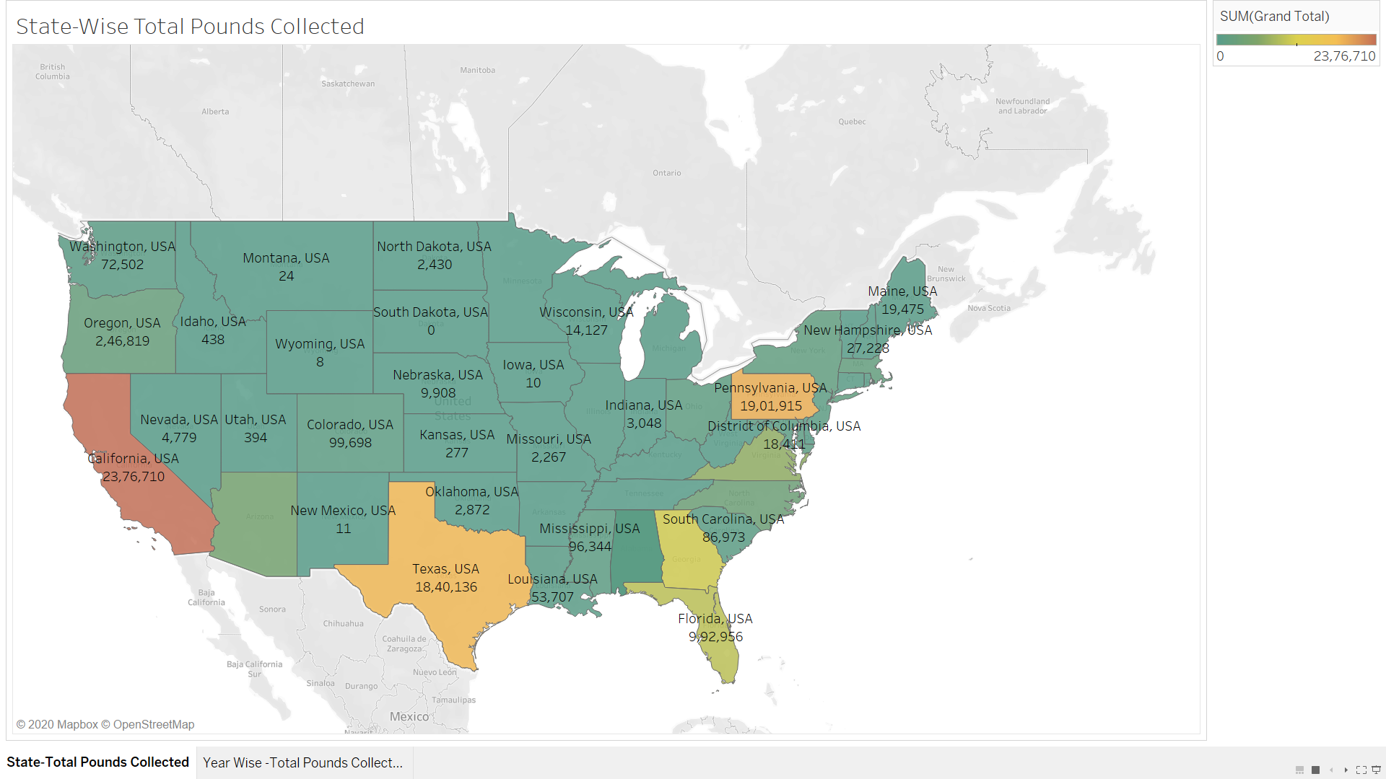
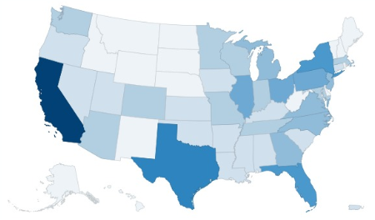
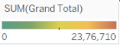
Which states collect what amount of trash(in pounds)?
Total Pounds Collected in Each State( 2015-2019)
- High population density areas such as: DC, New York, have very low number of pounds collected, but these states do have a good no.of lake and river bodies population density
States by their Coastal Area
With 253,343,400 pounds of trash on the US beaches alone, all the states combined, have been able to collect only 4.77% of all this trash, according to the dataset.

Slide 7
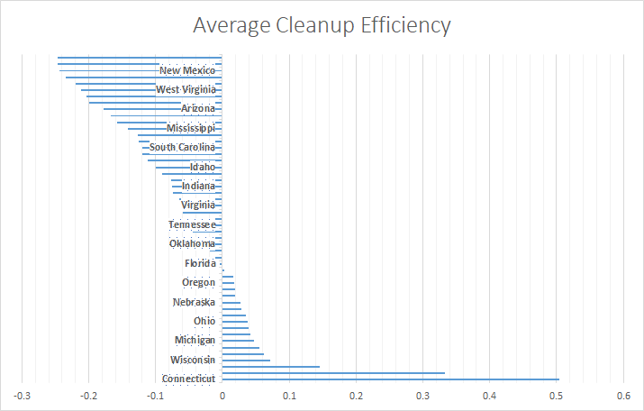
Average Items Collected Per Person
Are we collecting the same items per beach cleanup or are you slower?
We can see that there is a huge difference between the items collected per person in various states. This intrigued us into exploring the type of trash collected
Florida have collected a lot of beach trash through a lot of beach cleanup events actually see each person collecting very few trash items
Items Collected Per Person = Total Items collected
No. of people

Slide 8
Trash-Type Analysis
1
Which types of trash are collected in each state?
How has trash collection changed over time by trash types?
2
3
Does collecting Tiny trash require more human resource compared to Larger trash?

Slide 9
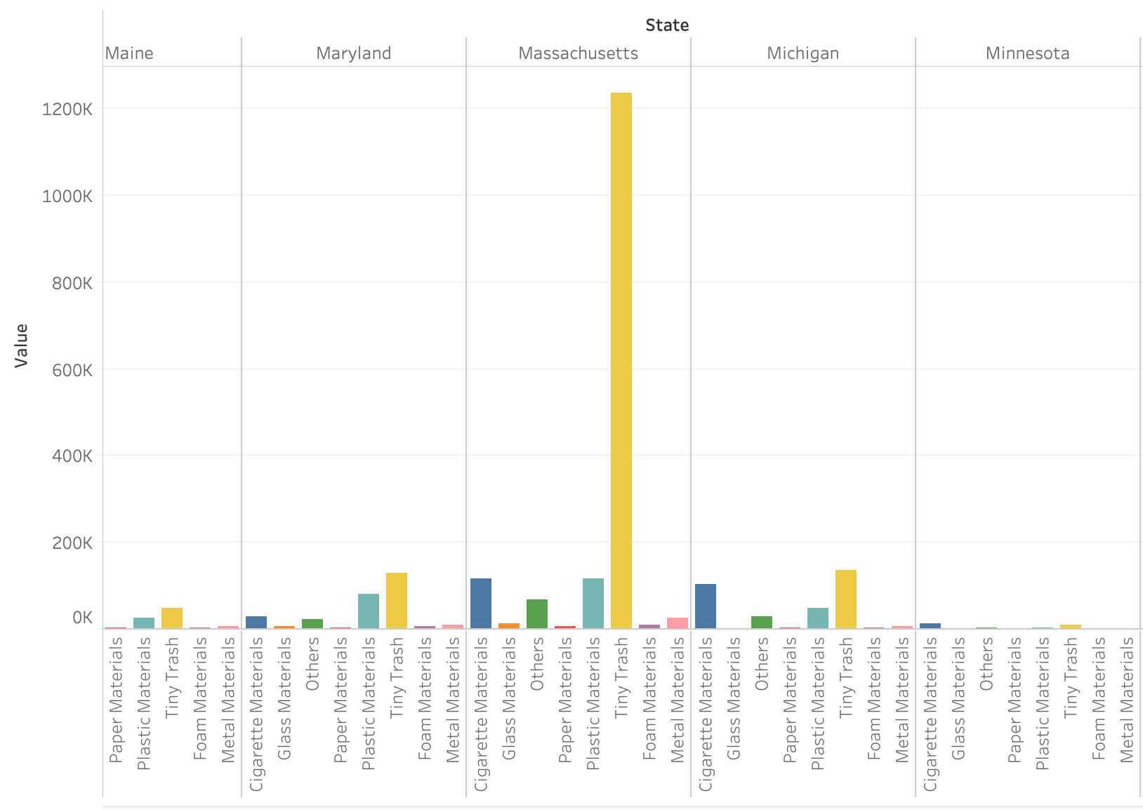
Number of Trash Items In each State For Each Type
Common Types:
Tiny trash
Cigarette Materials
Plastic Materials

Slide 10
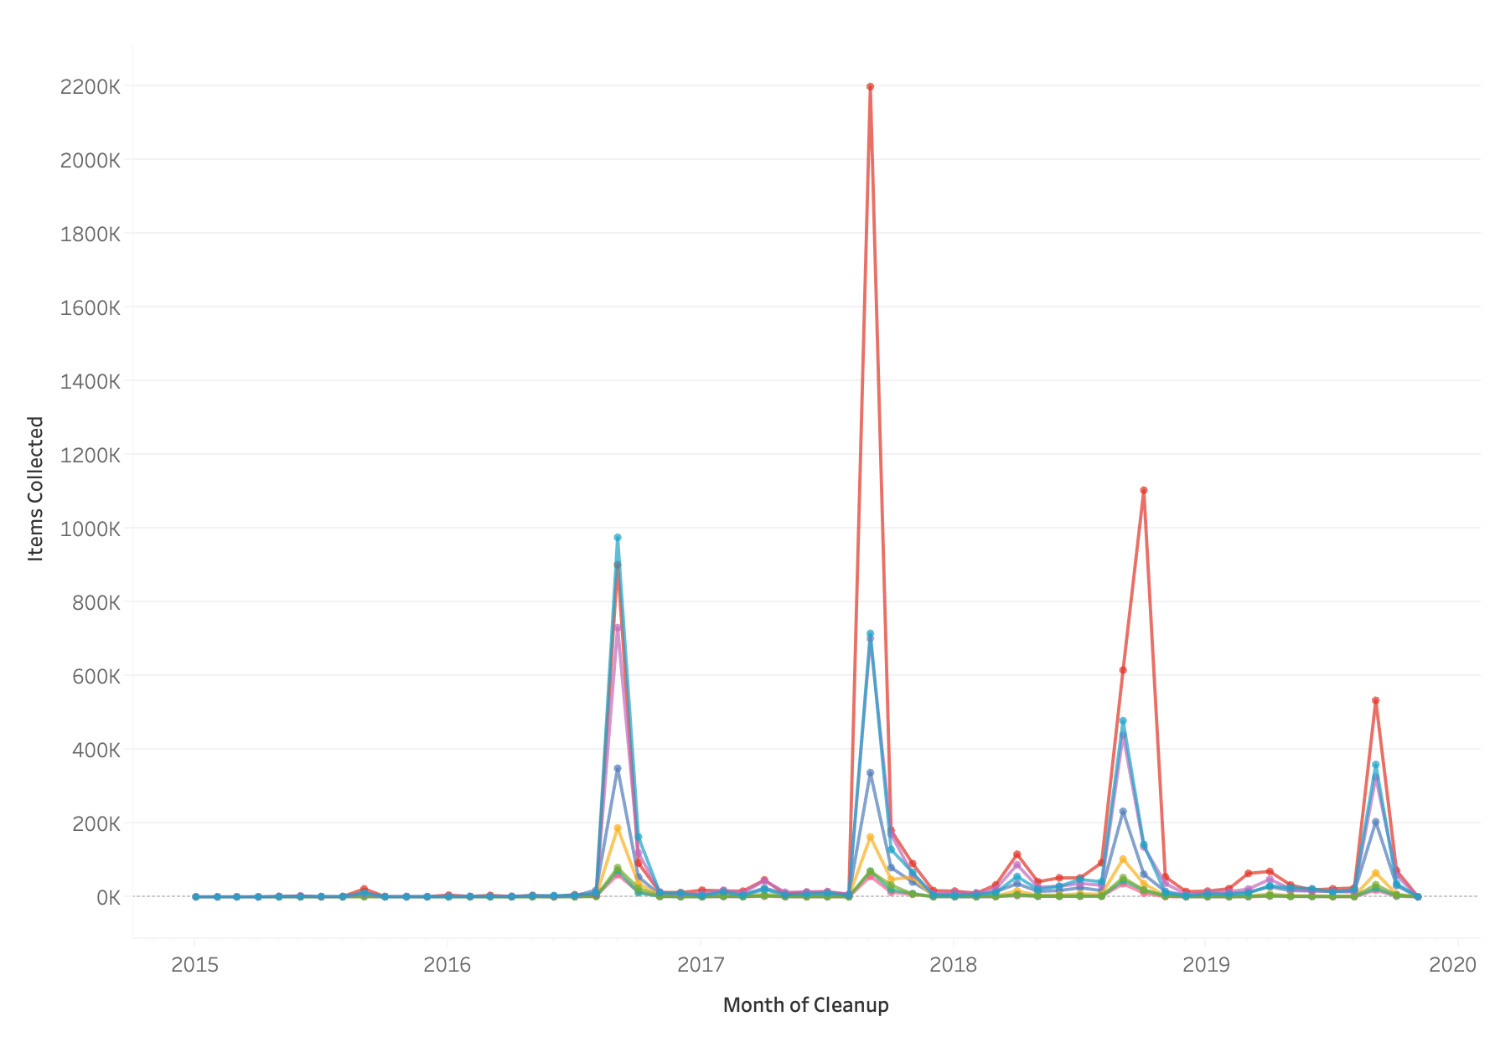
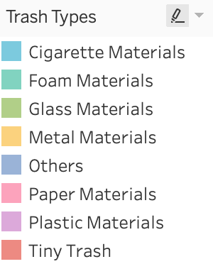
Types of Trash
over time
Massive Cleanup Event Dates
Massive Cleanup Event Dates:
ICC Day
Earth Day
National Cleanup Day
World Cleanup Day

Slide 11
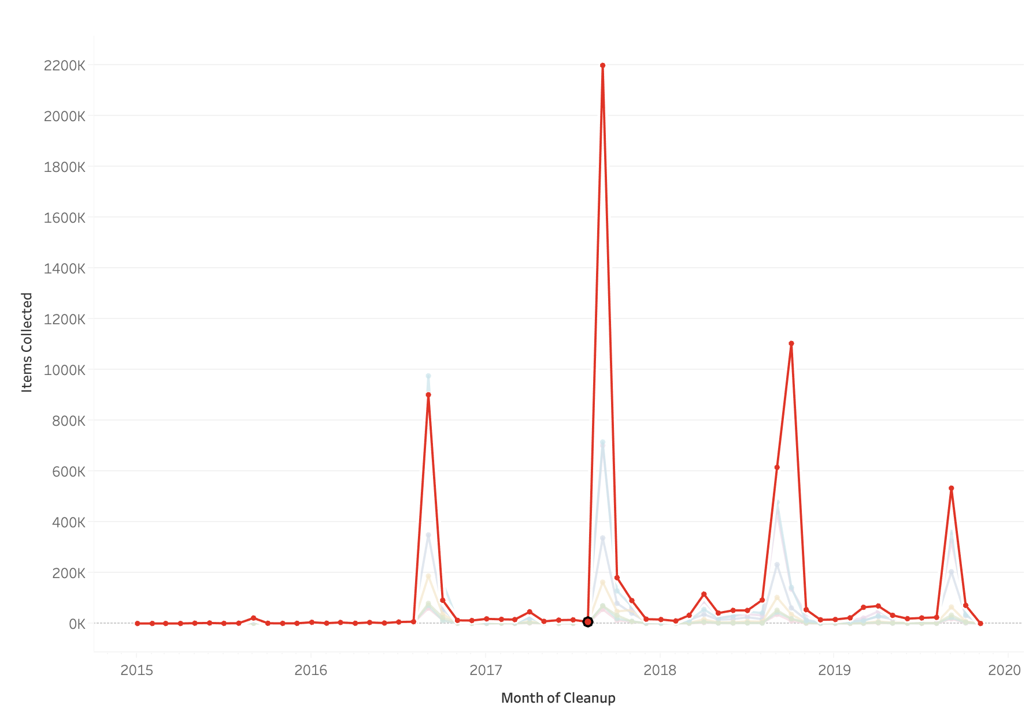
Tiny Trash Items collected over time
= Less Than 2.5 cm pieces:
Foam Pieces
Glass Pieces
Plastic Pieces (the most out of the three)

Slide 12
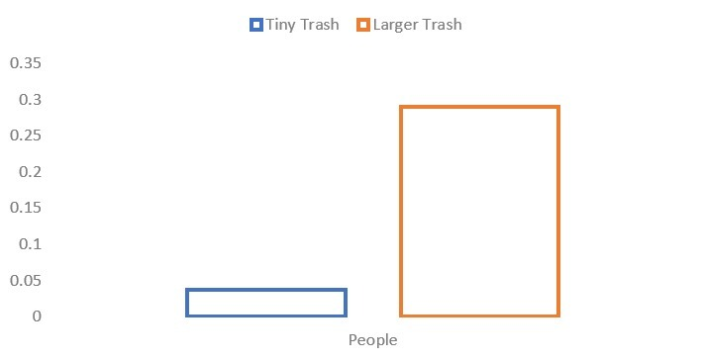
Correlation
In general, less people collect Tiny Trash.

Slide 13
Organization Analysis
1
Are children the main power to cleanup?
2
Does children engagement increase the cleanup efficiency of group?
3
Do individuals, on average, work more efficiently than groups?
4
What’s the relationship between group size and beach trash collection performance?

Slide 14
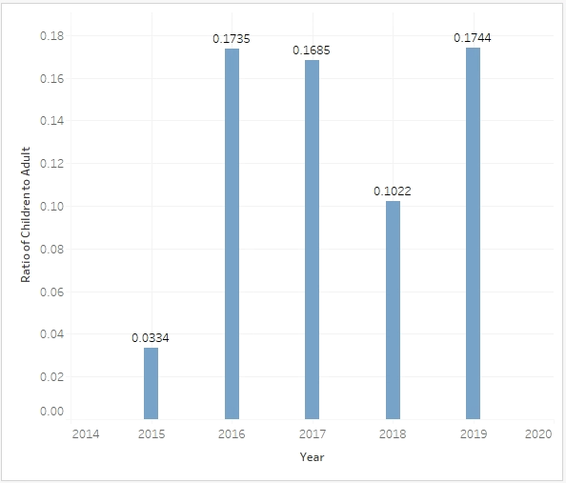
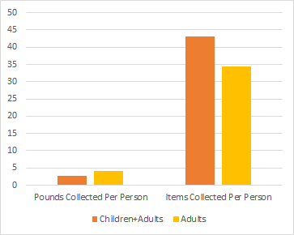
Children Effect: What’s the children effect on cleanup?
Do children have a positive influence on teams’ behaviors?
When there are children in the group, weight of garbage collected is lesser
If there are children in a group,
Group members prefer to collect light-weight trashes rather than heavy items and they have motivation to spare more effort on beach cleanup.
Adults, but not children, are the majority contributors of ocean cleanup.

Slide 15
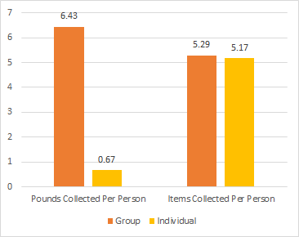
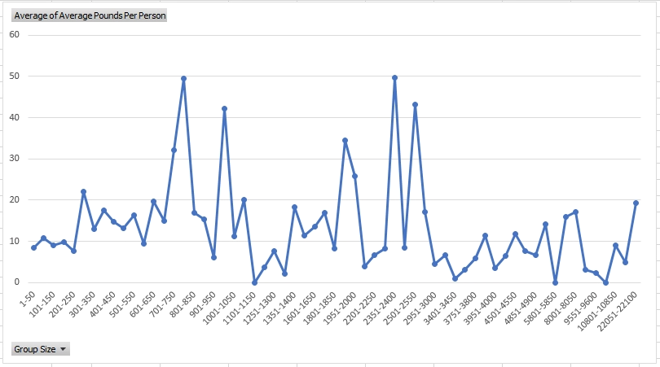
Group Effect: Does group affect the efficiency of cleanup?
Efficiency
Efficiency: Group > Individual
Heavier garbage removal undertaker: Group
Does group size matter?
The size of groups impacts cleanup efficiency
Three peaks: 250, 800 and 2400
Cleanup efficiency & extra benefit of one more members: size to be controlled under 800.

Slide 16
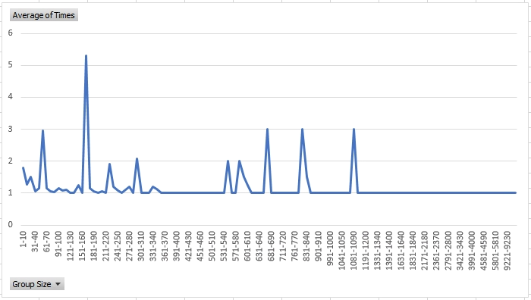
Group Effect: How often do different size groups do cleanup?
Most frequent cleanup organizations : Keep Pandolph County Beautul
cleanup organizations contributing most: SOLVE
Not representative data: each range contains insufficient number of groups
Irregular Behaviour of smaller groups

Slide 17
Prediction
Ocean cleanup organizers want to predict:
With an estimated amount of trash (number of items, number of pounds), on weekend, in August, within five miles.
=> how many people needed to do the cleanup?

Slide 18
Prediction
Data Preprocessing
Exploratory data analysis
Data Normalization
Missing-value treatment
Feature engineering
Model development
(please see our jupyter notebook file)

Slide 19
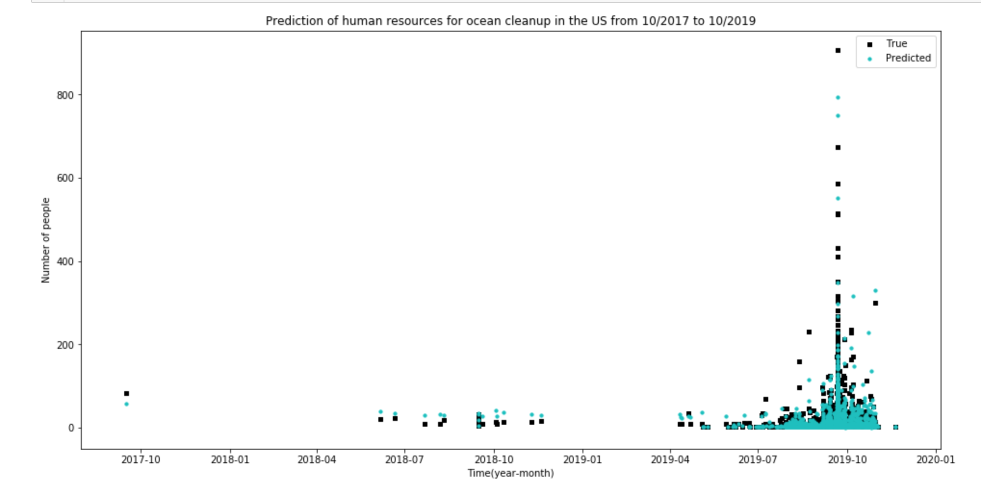
Prediction

Slide 20
Prediction
Metrics: RMSE
RMSE baseline: 163.47
RMSE of our model:
Xgboost: 83.57
Lasso linear regression: 86.77
Data
Training set: 75%
Test set: 25%
10-fold cross-validation
Features
Total Items Collected
Month
Weekend
Pounds
Miles

Slide 21
Recommendations

Slide 22
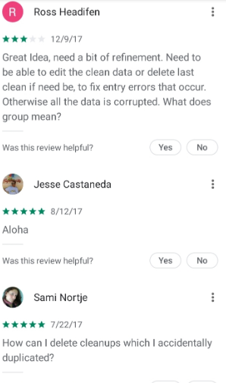
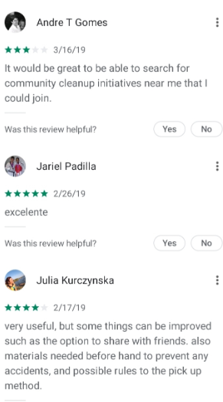
Data collection process
Improve Cleanswell Apps:
There should be fields that need to be mandatorily filled and some fields should be entered numerically
Trash Types: No need to sub-classify items collected to a very specific level; rather classify broader categories that people would easily understand, would minimum user effort and increase data quality
Synchronize Trash categories with website form
Create a landing webpage that connects users with nearby beach cleanups

Slide 23
Data Analysis
We should have more beach cleanup activities in high population density areas
We should have more beach cleanup activities in inner states with significant water bodies like lakes and rivers
Distribute cleanup events more evenly throughout the year
Leverage Machines for the huge amount of tiny trash
Human Resource should be concentrated on picking up larger trash
Improve the group’s diversity by teaming adults and children
Upon adding a new member to a large group, it does not improve the cleanup efficiency, so medium sized groups(<800) need to be formed
People perform cleanup more frequently when with NGOs compared to private groups. So, people should be encouraged to join NGOs for beach cleanups
State-Wise Analysis
Trash Analysis
Organization Analysis

Slide 24
Prediction
Estimate the human resources allocation for a certain area based on the estimated amount of trash (number of items, number of pounds), date, and seasonality.
=> recommendation system that will be potentially helpful for environmentalists to estimate and optimize human resource recruitment in their campaigns.

Slide 25
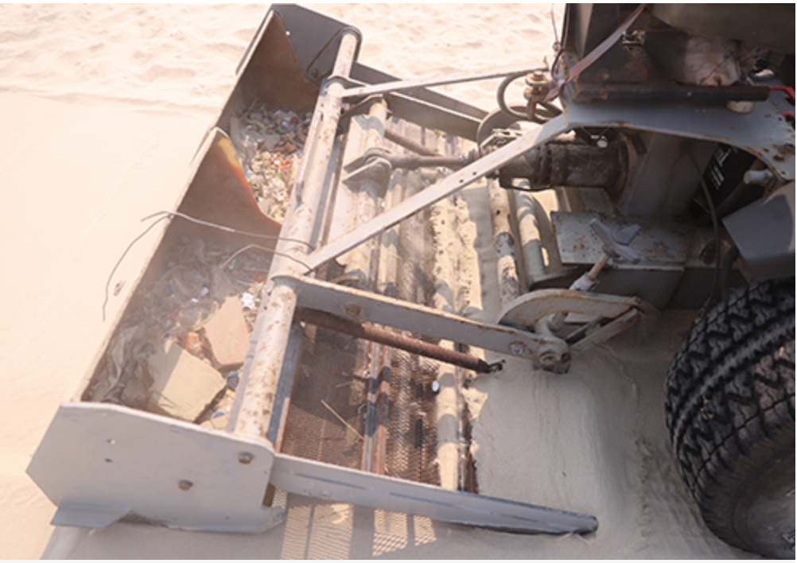
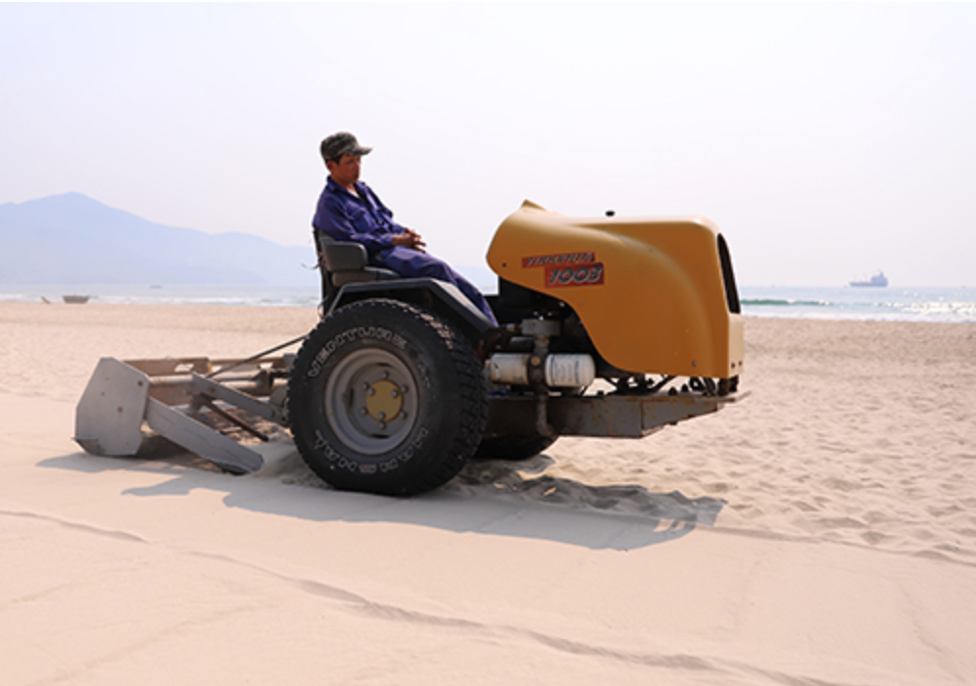
Recommendations - Technical solutions that enhance the human resource
Ocean cleanup machine for tiny trash from Da Nang beach in Vietnam.

Slide 26
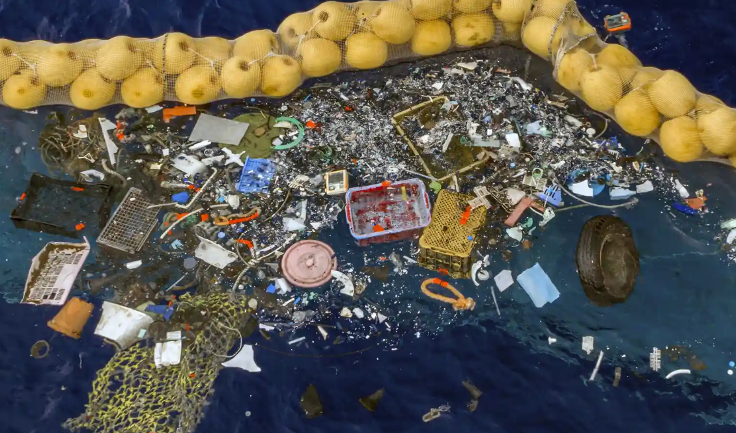
Floating trash collectors for tiny trash
These can be set up a little distance from beach shore lines so that trash is not washed away into the deep waters but rather collected and recycled

Slide 27
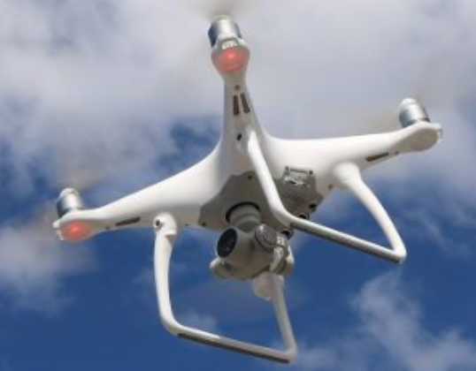
Beach Cleaning Drones
These AI driven drones have the capability of detecting plastic in the sand
This way people can pinpoint their clean-up efforts
Eg: This drone could fly on a handful of beaches and record data about how much plastic waste exists on each beach. This way cleanup groups/individuals can more efficiently select beaches to clean.

Slide 28

How would we broadcast this newly found information?
Reddit/ Other Social Media
Reach out to various targeted customers and present this newly found information to them
Reach out to the tourism industry and businesses/govt agencies located near beaches
With due respect to the upcoming elections, we could reach out to prospective candidates who are proposing environmental friendly policies

Slide 29
Questions?

Slide 30
Thank you.

